Slide 1
A Data Scientist’s Approach to working with Geospatial Data
Jeremy Seibert
Graduate Student at the University of Southern Indiana
https://github.com/Jaseibert
Jaseibert2@eagles.usi.edu

Slide 2



My Background
Former Data Scientist, Intern at CPHandheld Technologies
Current M.B.A in Data Analytics Student
Recent Market Research Analyst at Vectren Corp

Slide 3

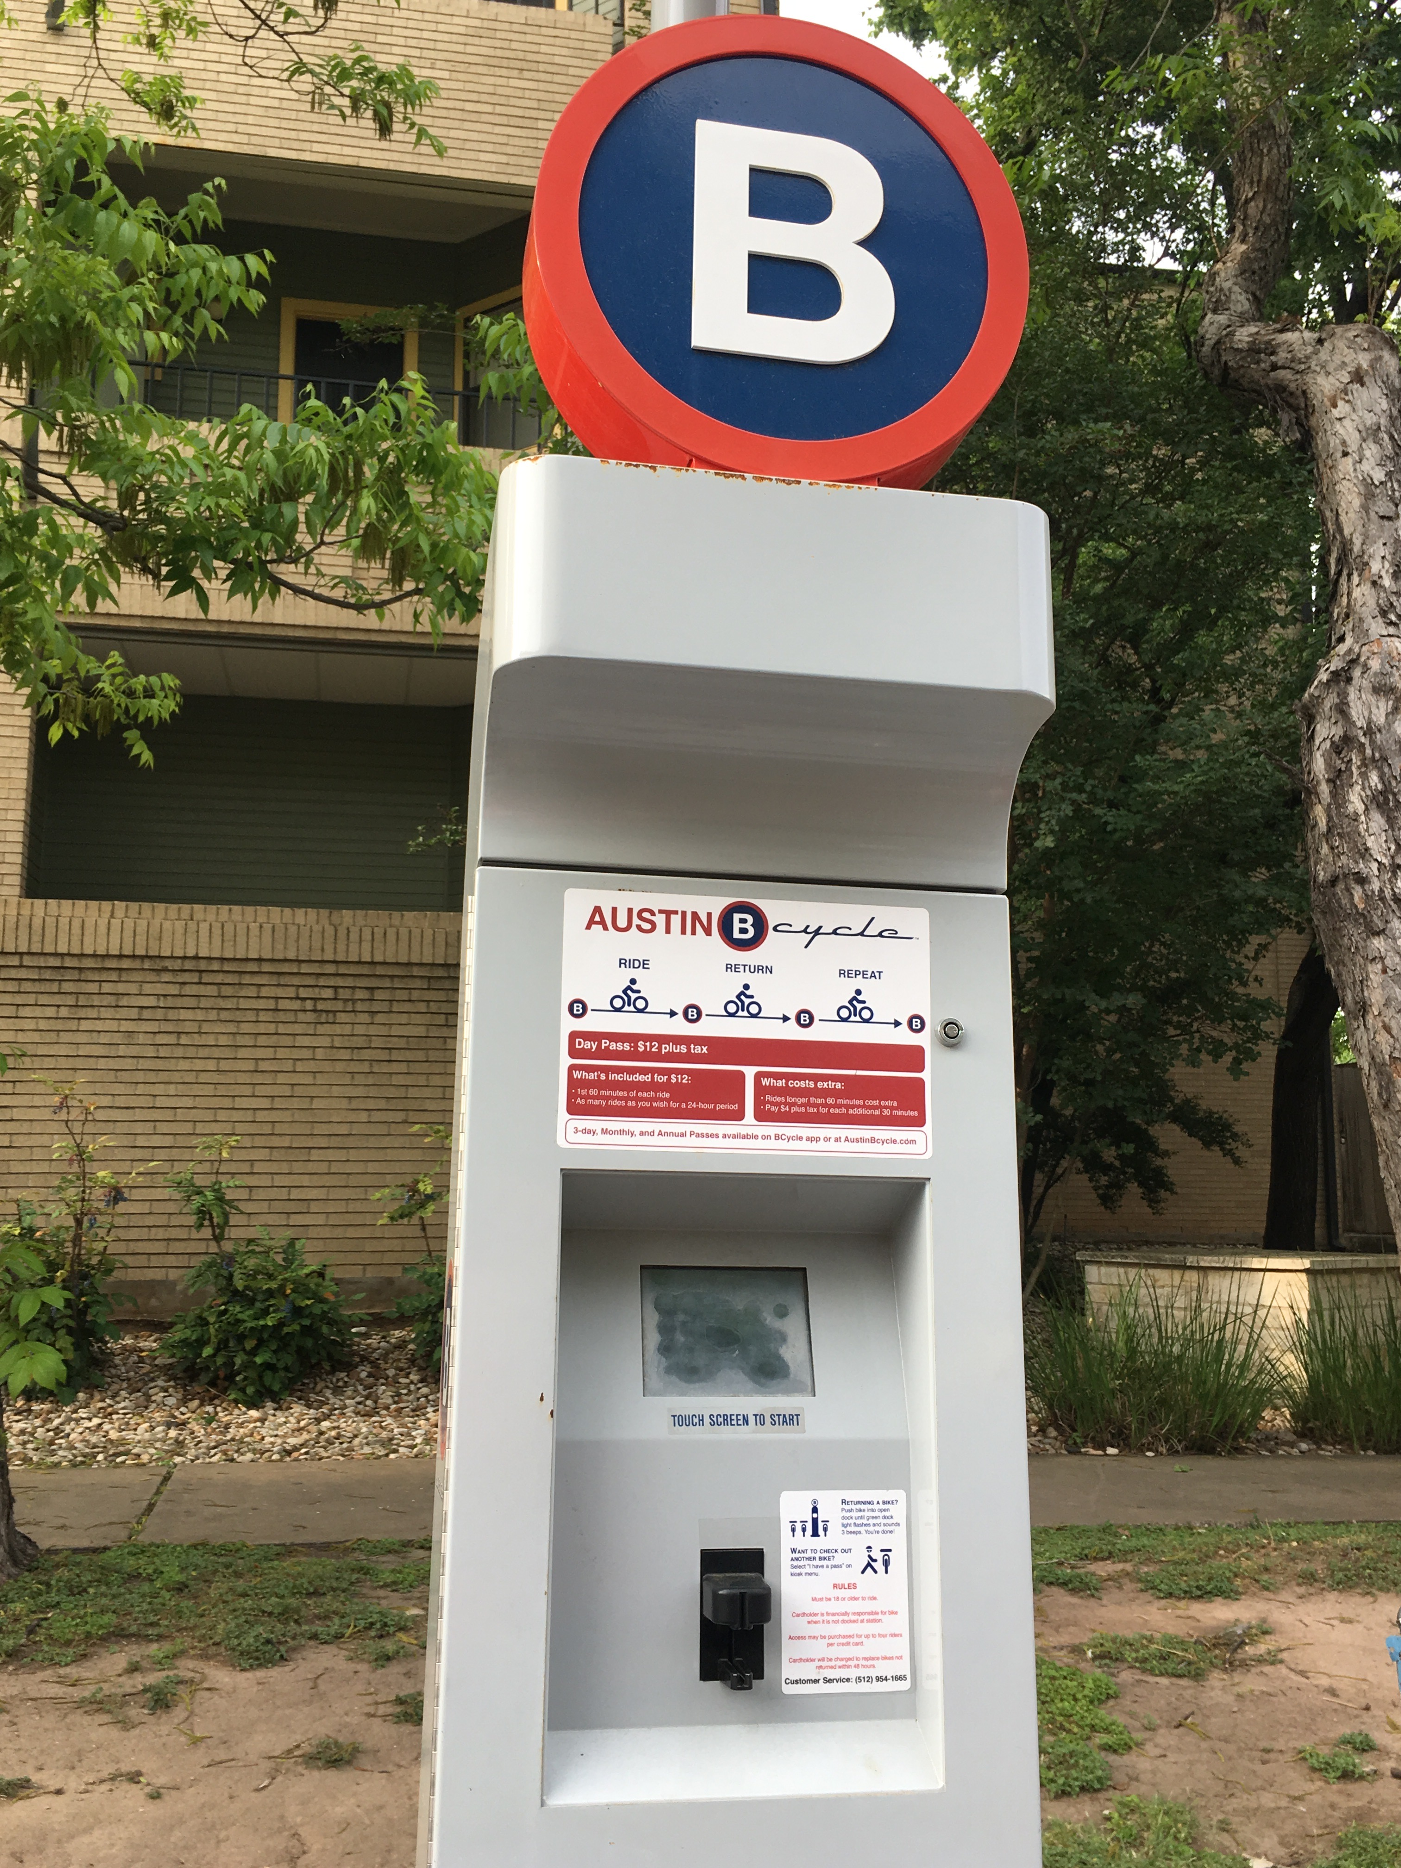
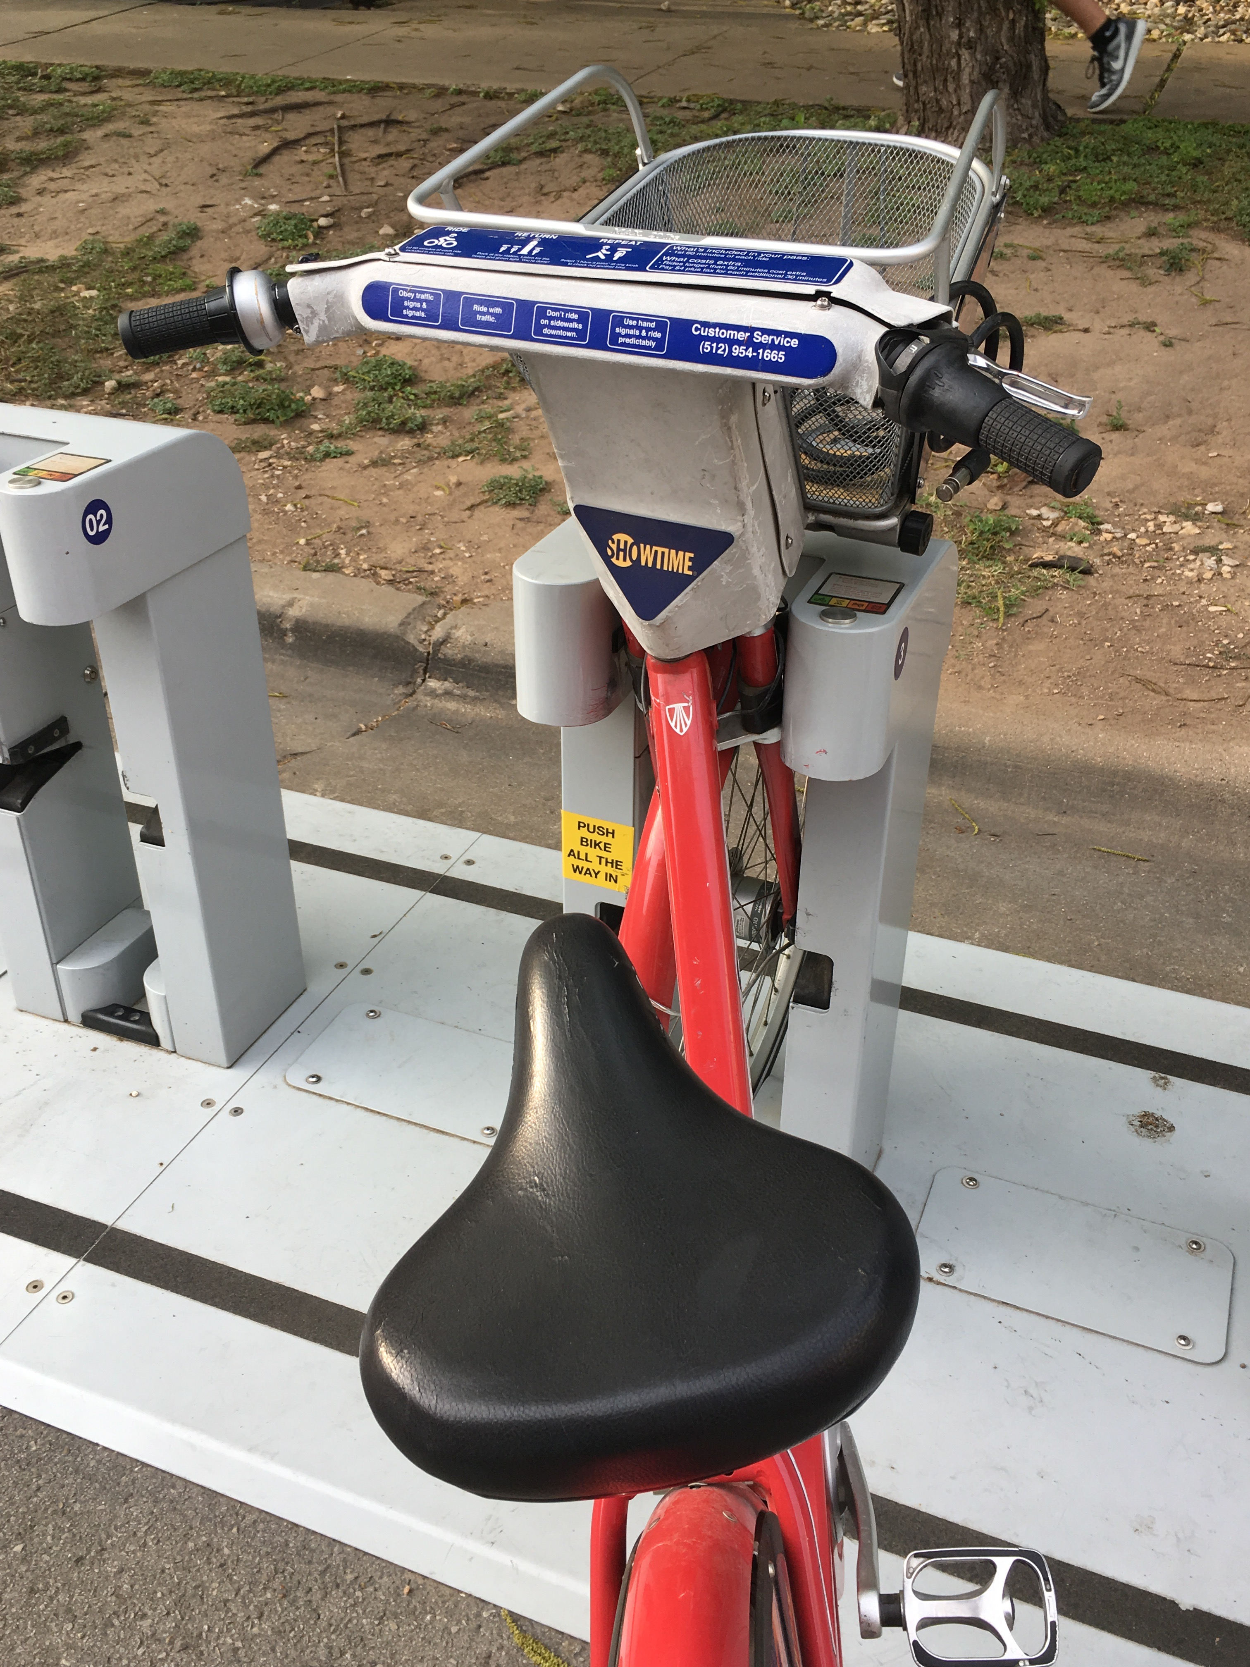
My Background with GIS
Master’s Thesis: on Micro-Urban Transportation (Bike Share Programs) & their Potential Economic Effects on the Urban Environment.

Slide 4
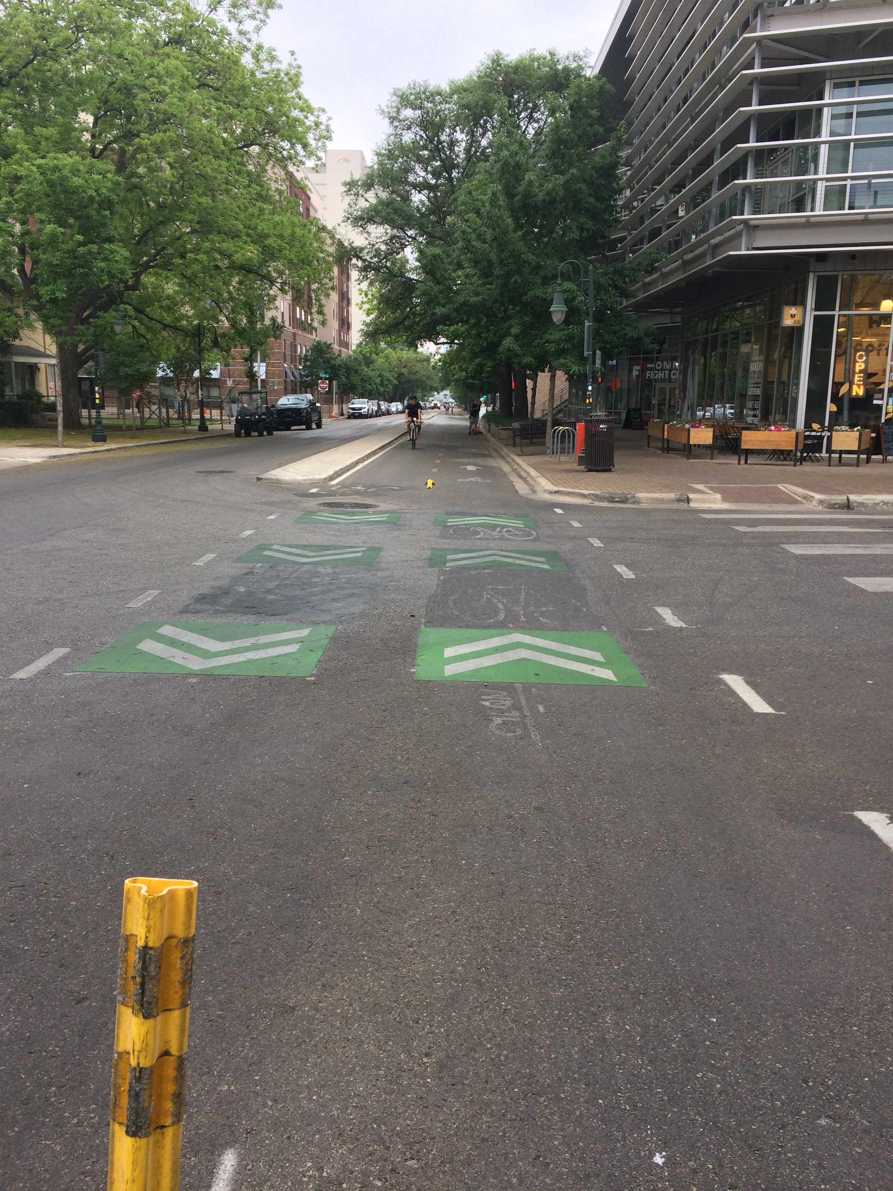
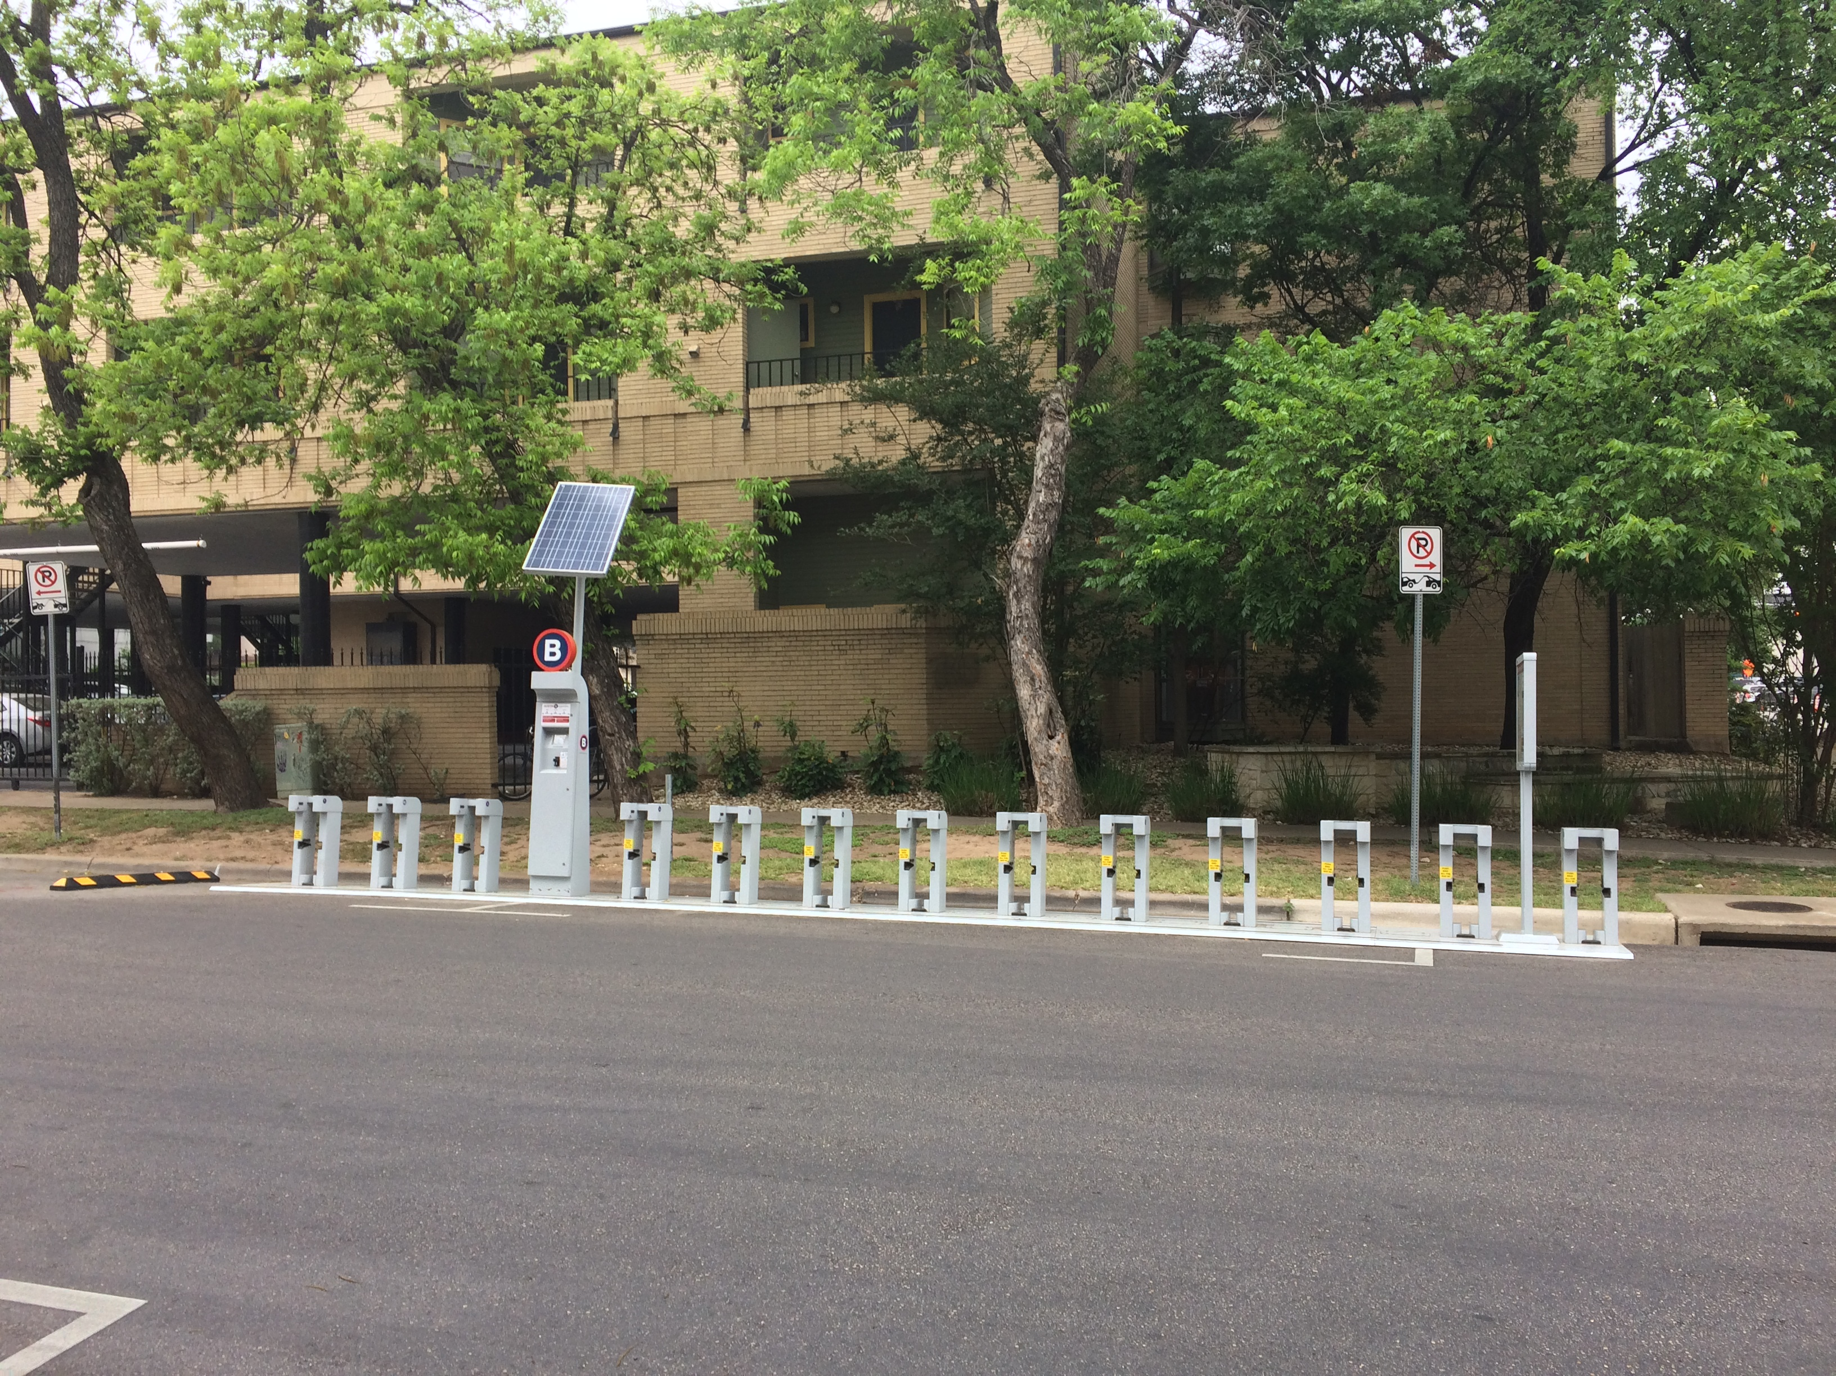

Slide 5
Why?

Slide 6
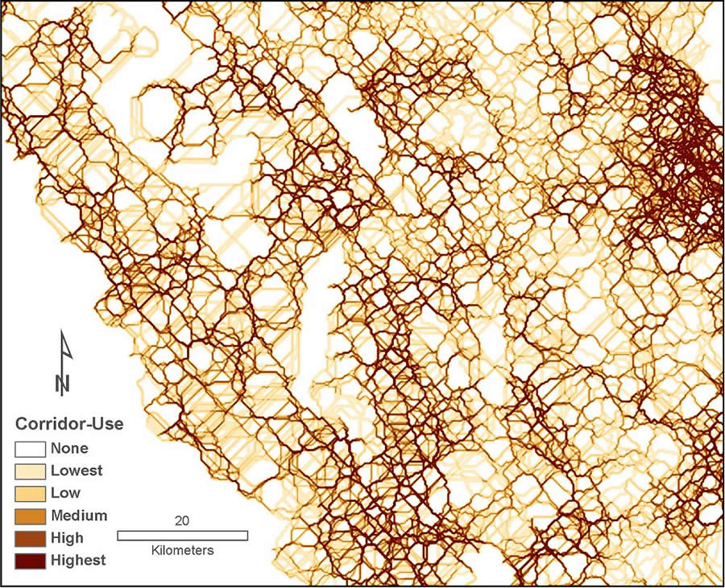
Biodiversity Visualization & Analysis
A thematic map visualization of Grizzly Bear corridors in southern Canada.
Photo Credit: ESRI & University of Calgary

Slide 7
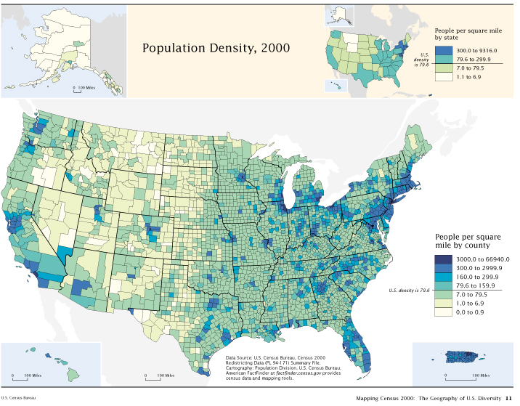
Census/Population Visualization & Analysis
A thematic Map recording the relative population density within US counties according to the 2000 US Census.
Photo Credit: US Census Bureau

Slide 8
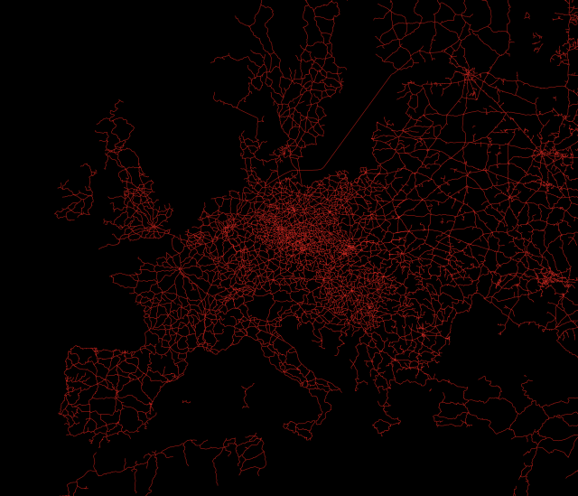
Transportation Visualization & Analysis
An interactive thematic map created to model the world railway system.
Map Link:
https://team.carto.com/u/santiagoa/viz/d1ac8b98-6f5d-11e4-b990-0e018d66dc29/embed_map
Photo Credit: Carto & Santiago Giraldo Anduaga

Slide 9
Learning Objectives

Slide 10
Fundamental Cartography & Geodetic Concepts
Basics of GIS and Geospatial data
Develop an understanding of the most up-to-date GIS tools
Walk-through python packages for data visualization and analysis (Python 3.6)

Slide 11
Fundamental Concepts of Cartography

Slide 12
Coordinate Systems
Geodetic Datum’s
Geometric Constructs & Approximations

Slide 13
Coordinate Systems

Slide 14
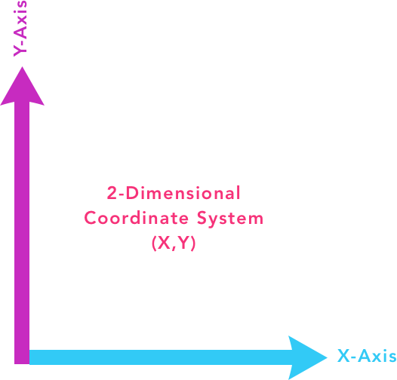
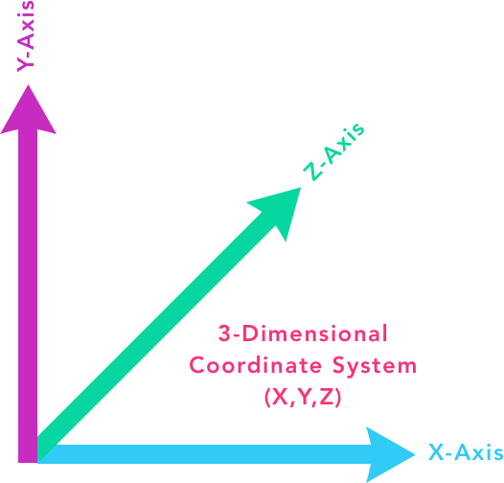
Every spatial dataset has at least a 2-dimenstional coordinate system (X,Y)
More accurate GIS datasets (i.e. CRS) include an 3rd axis defined by variable (Z)

Slide 15
Geodetic Datum’s

Slide 16
A datum is a model that approximates the shape of the earth to enable accurate position, length, and area calculations (X,Y,Z).
There are 3 primary Geodetic Datum’s:
The 2 Horizontal Datum’s can be thought of as the constructs of the 2-dimensional coordinate system (i.e. Latitude & Longitude) or (X, Y).
The 1 Vertical Datum refers the Z-axis in the 3-dimensional coordinate system and is the unit of measurement for elevation/altitude.
The 3 Geodetic Datums are the foundation of any Coordinate Reference System (CRS).
The most common Coordinate Reference System the World Geographic System created in 1984 (WGS84)

Slide 17
Geometric Constructs & Projections

Slide 18
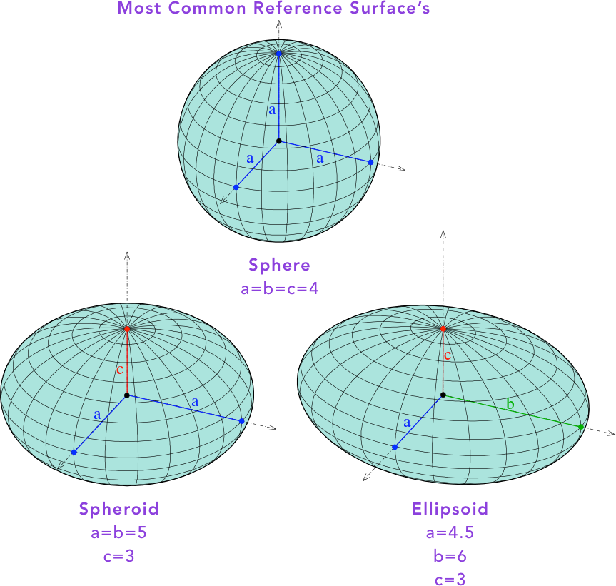
Cartographers refer to the 3-D representation’s shape, as a Reference Surface, or a Reference Ellipsoid.
Sphere: All 3 Axes have equal length.
Spheroid : 2 Axes have the same length.
Ellipsoid : All 3 Axes have different lengths.

Slide 19
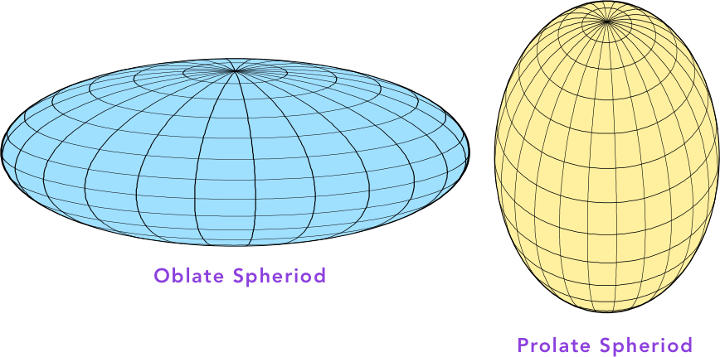
The Actual surface of the Earth is NOT a perfect sphere.
Rather it’s reference surface is best modeled as an Oblate Spheroid
The WGS84 CRS uses a spheroid whose radius is 6,378.137 km (3,963.191 mi) at the equator & 6,356.752 km (3,949.903 mi) at each pole.

Slide 20
Basics of GIS and Geospatial data

Slide 21
Technology used to collect Geospatial Data

Slide 22
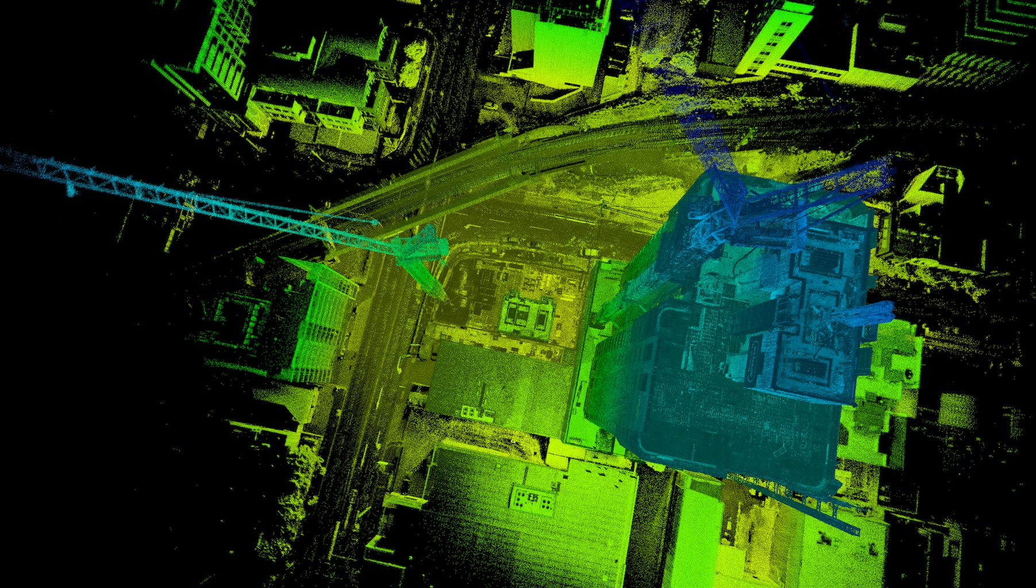
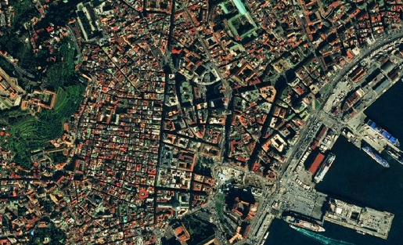
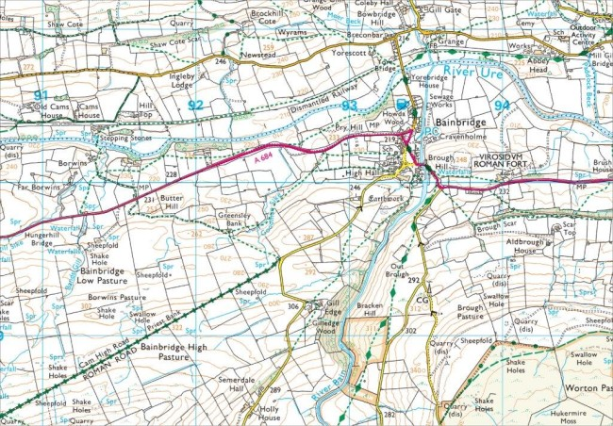
High-Resolution Lidar Image
Data Capture
Satellites (Imagery or Differential GPS)
Drones/UAV (Lidar)
Surveyors
Data Digitization/Processing
Manual Landmarking/Geocoding
Image Classification (ERDAS or ENVI)
High-Resolution Satellite Image
A Modern Surveyor’s Rendering

Slide 23
2 Spatial Data Types

Slide 24
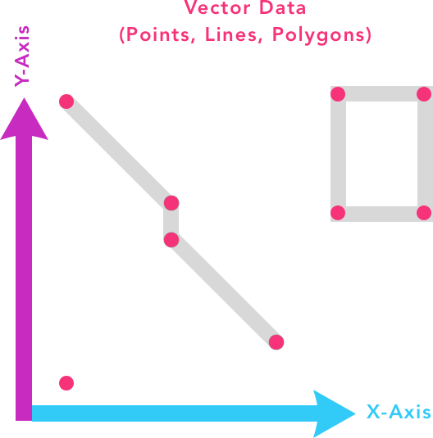
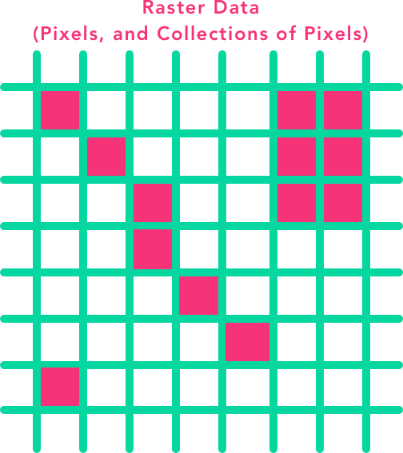

Slide 25
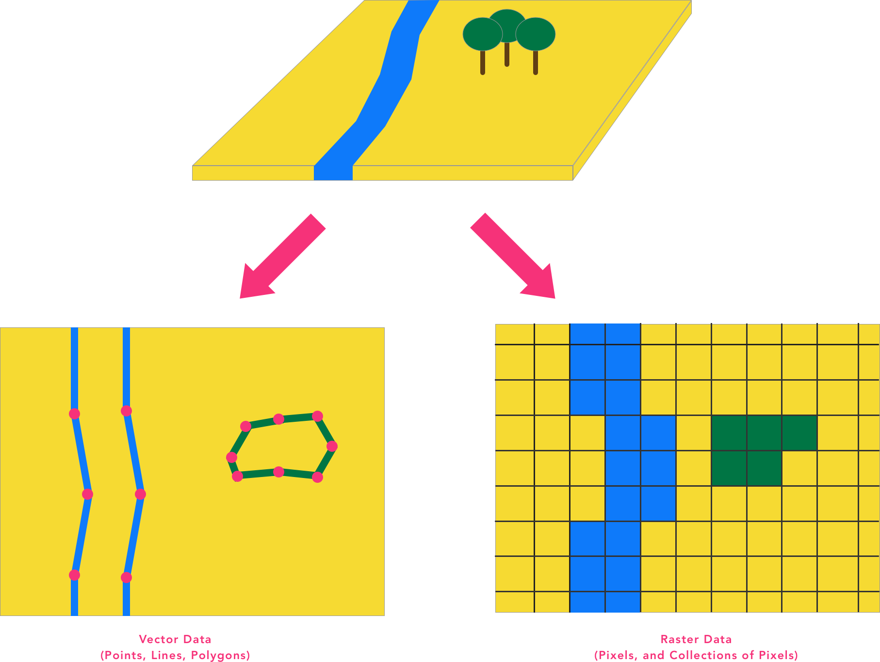

Slide 26
VECTOR
RASTER
Points, lines, polygons
Features with discrete shapes and boundaries (e.g., street, land ownership parcel, well)
Database management
Database Query and reporting
Network Analysis
High quality maps
More closely resembles real world
Spatial analysis and modeling
Areas broken into ‘pixels’ or cells, each containing data
Good at representing dense data
Continuous surfaces with fuzzy boundaries or with qualities that change gradually over space (e.g., soil, land cover, vegetation, pollution)
Spatial analysis and modeling (e.g. agricultural sustainability)

Slide 27
Python Geospatial Ecosystem

Slide 28
Frameworks
Geopandas (Analysis & Visualization)
Folium (Visualization)
OSMnx (Python for Street Layers)
Geopy (Coordinate References/database)
Rasterio (Python for working with spatial raster data)
Leaflet.js (Underlying functionality for Folium)
Geoplot (more High-level spatial Visualization)

Slide 29
Expanded Geospatial Ecosystem

Slide 30






Slide 31
Lets Jump in to the code!

Slide 32
GeoPandas Summary

Slide 33
Read and Write using a variety of file formats (GeoJSON, JSON, CSV,…)
Familiar manipulation of attributes ( Pandas DataFrame)
Spatial Operations (unions, difference, within, …)
Quick Visualization of Geometries (matplotlib, folium)
More Advanced Spatial operations (Spatial Joins, overlays, …)

Slide 34
Folium Summary

Slide 35
Folium can Read and Write (GeoJSON, TopoJSON, CSV,…)
Works Congruently with Pandas for Dataframe Manipulation
Build Interactive Maps
Different Map Styles
Utilizes Full Functionality from Leaflet.JS (Draw, Export to HTML, …)

Slide 36
Framework Documentation

Slide 37
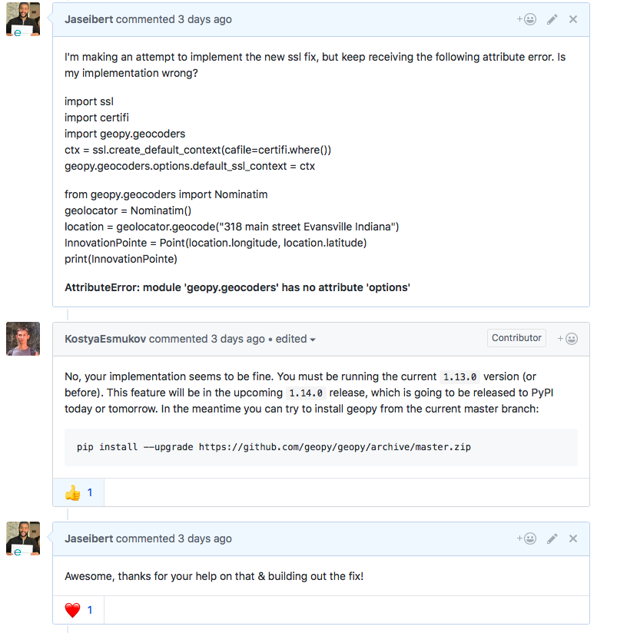
OSMnx (Documentation)
Geopandas (Documentation)
Folium (Documentation)
GeoPy (Documentation)
Leaflet.js (Documentation)
Rasterio (Documentation)
Geoplot (Documentation)

Slide 38
Wrap-Up

Slide 39
Fundamental Cartography & Geodetic Concepts
3 Basics ( Coordinate Systems ,Datums, Geometric Shapes)
Basics of GIS and Geospatial data
Vector v. Raster
Collection techniques
Develop an understanding of the most up-to-date GIS tools
Python Ecosystem
GIS Ecosystem
Using Python we worked with:
GeoPandas
Folium
GeoPy

Slide 40
Any Questions?

